Slide 1
Math 530/630: CM 4.5
Errors, Effect Size and Power

Slide 2
When the null hypothesis is true
1-sample t-test
n = 25
Notes:
Let’s review…

Slide 3
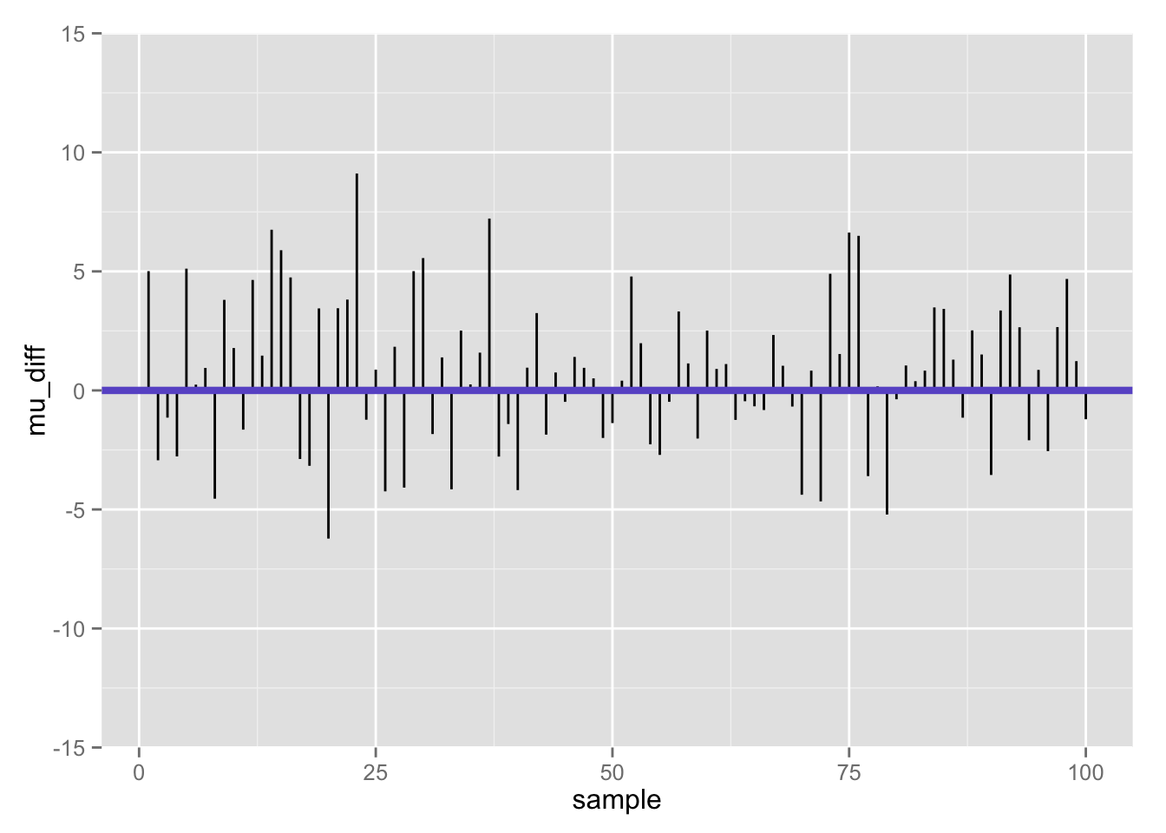
Differences between population mean and sample mean (100 samples) when null is true
Notes:
Sampled from t-distribution with mean 100, computed mean, then computed difference from 100
Guess a sample size of 25 – since that’s relevant

Slide 4
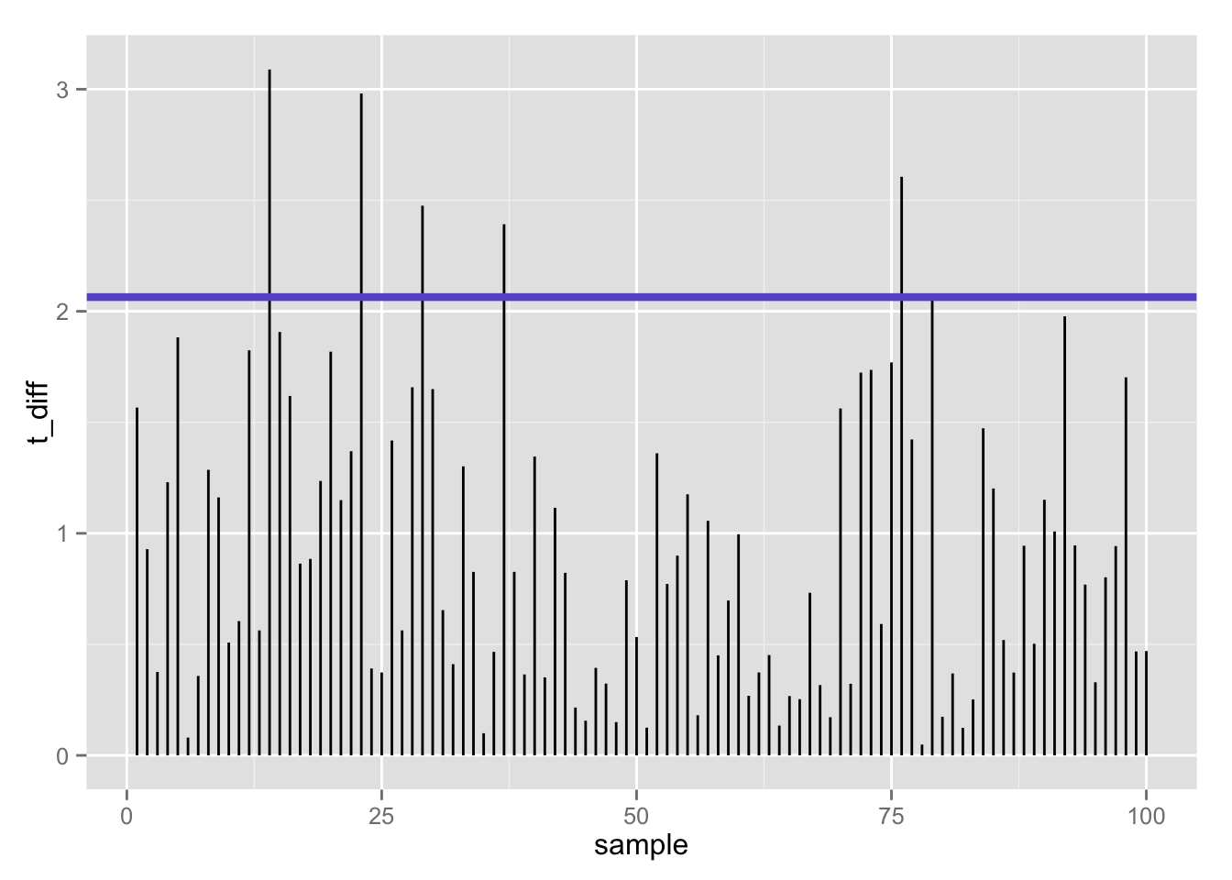
100 t-statistics (absolute value) when null is true: 5% false positives using t-test (𝛂 = .05)
Notes:
Critical value ~2+

Slide 5
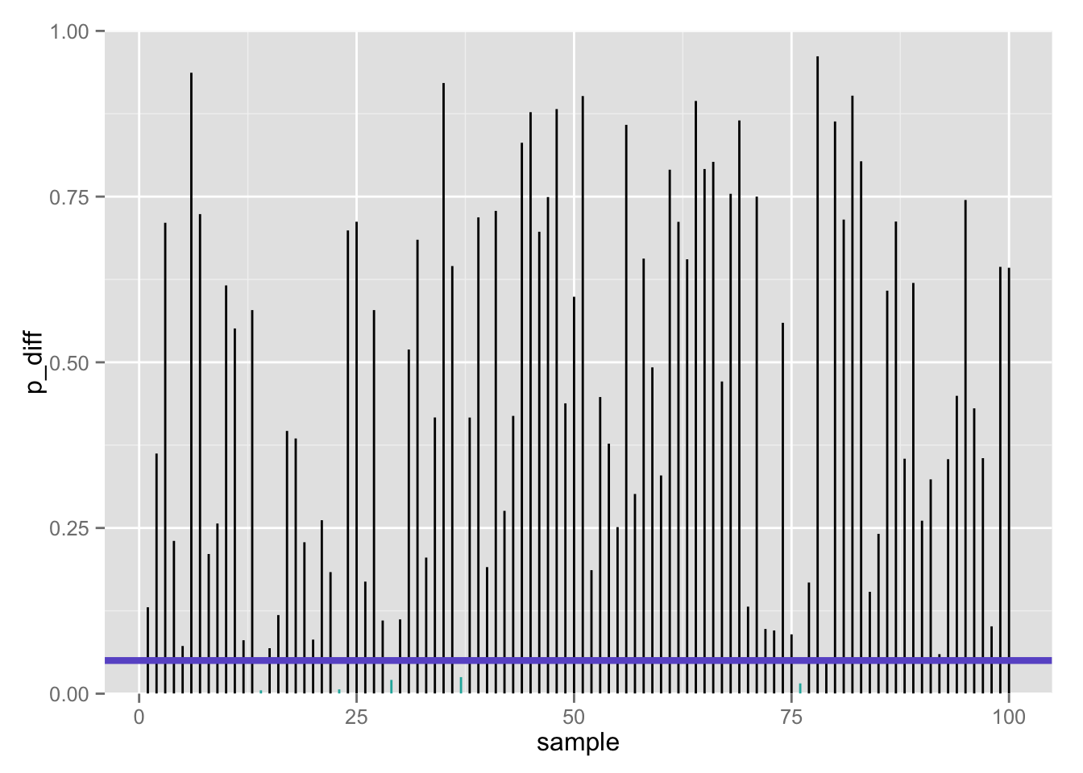
100 p-values when null is true: 5% false positives using t-test (𝛂 = .05)
Notes:
P-value < .05

Slide 6

Confusion matrix
 | Call based on observed data
True state of the world | Fail to reject H₀ | Reject H₀
H₀ | True negative 1 – 𝝰 | False positive Type I error 𝝰 | # true H₀’s
H₁ | False negative Type II error 𝛃 | True positive 1 – 𝛃 | # true H₁’s
 |  | # rejected H₀’s | # total tests
If the null is true…
Notes:
~95 were correctly not rejected (true negative), but ~5 were rejected (false positive)
Why we set alpha - to control type I errors!
Each row sums to 1

Slide 7
Confusion matrix
 | Call based on observed data
True state of the world | Fail to reject H₀ | Reject H₀
H₀ | True negative 1 – 𝝰 | False positive Type I error 𝝰 | # true H₀’s
H₁ | False negative Type II error 𝛃 | True positive 1 – 𝛃 | # true H₁’s
 |  | # rejected H₀’s | # total tests
But… what if we are wrong??
Notes:
What if we falsely fail to reject H₀, when the alternative is in fact, true?

Slide 8


Two ways we can be wrong…
Type 1 error (𝛂)
False positive
Type II error (𝛃)
False negative
“You’re not pregnant”
“You’re pregnant”

Slide 9
One way we can be wrong…
Type 1 error (𝛂)
False positive
Call: reject H₀
If we had rejected the null, it is of course possible that we should not have!
That is, the true state of the world may be H₀ (he’s not pregnant), but our sample data leads us to reject H₀ and (incorrectly) conclude that he’s pregnant
This is really embarrassing, so we control this: 𝛂 = ?
“You’re pregnant”

Slide 10
The other way we can be wrong…
Call: fail to reject H₀
Type II error (𝛃)
False negative
If we conclude that we cannot reject the null, it is of course possible that we should have!
That is, the true state of the world may be H₁ (she’s pregnant), but our sample data says we don’t have good enough evidence to reject H₀ (she’s not pregnant)
“You’re not pregnant”

Slide 11

In our aspiring astronauts example…
Type 1 error (𝛂)
False positive
Type II error (𝛃)
False negative
Decide:
“You are smarter than average!”
Reality:
but you are actually not
Decide:
“You’re not smarter than average!”
Reality:
but you are actually

Slide 12

The boy who cried wolf caused both Type I and Type II errors, in that order.
First, everyone believed there was a wolf, when there actually was not a wolf.
Next, they believed there was no wolf, when there actually was a one.
Substitute “effect” for “wolf” - done!
Thanks to @danolner and @JustinWolfers for this one

Slide 13
What if: the null hypothesis is FALSE?
1-sample t-test
n = 25
Notes:
Return to the aspiring astronauts

Slide 14
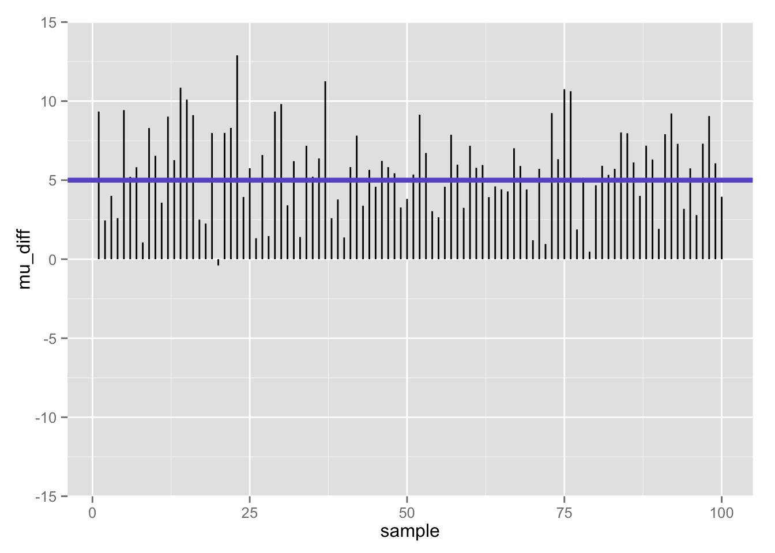
Differences between population mean and sample mean (100 samples) when null is false
Notes:
Alludes to our aa experiment…
Known mean difference of 5

Slide 15
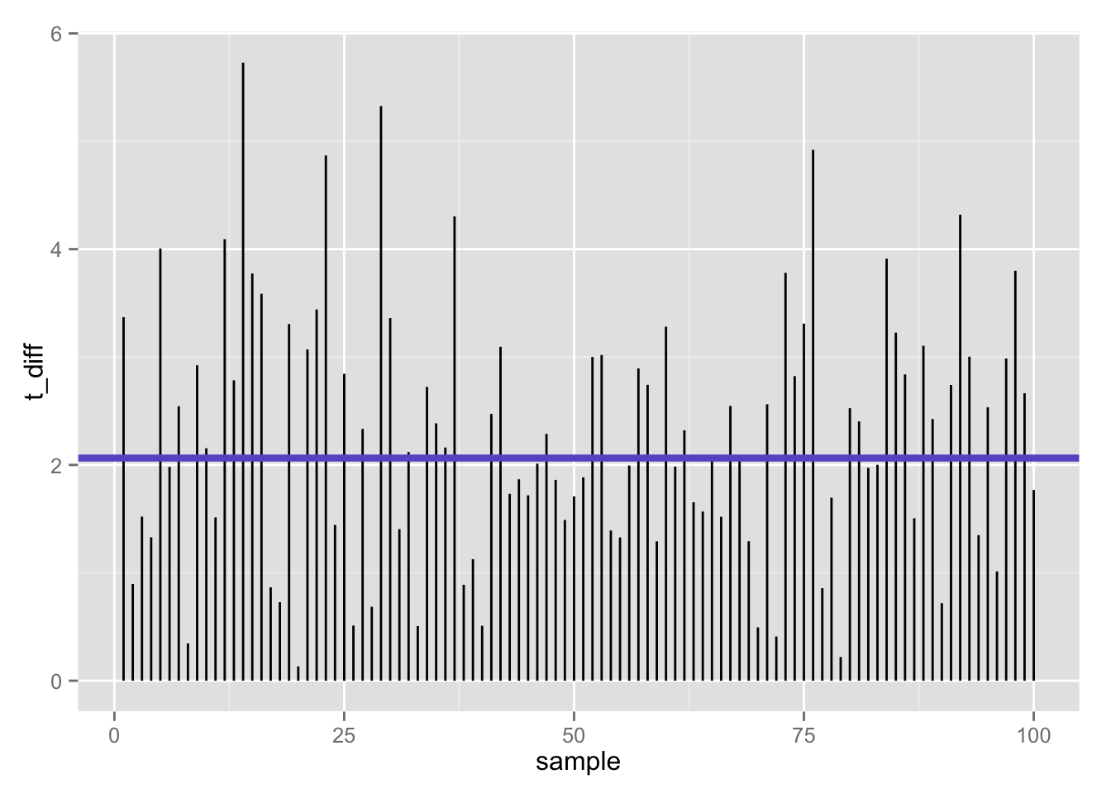
100 t-statistics (absolute value) when null is false: 47% false negatives using t-test (𝛂 = .05)
Flip side (1 −𝛃):
53% true positives

Slide 16
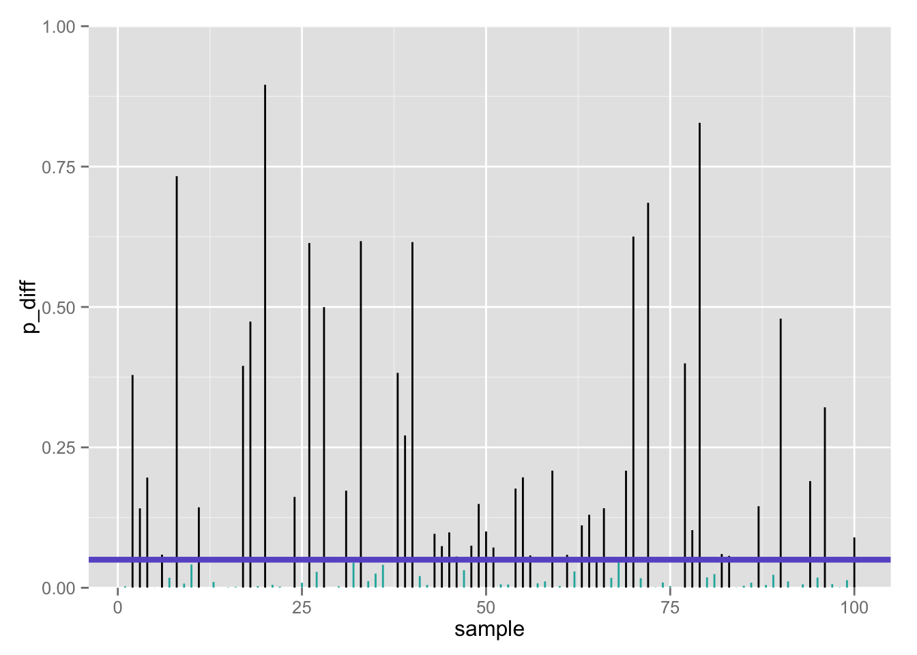
100 p-values when null is false: 47% false negatives using t-test (𝛂 = .05)
Flip side (1 −𝛃):
53% true positives

Slide 17
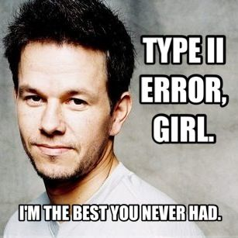
Type II errors
The one(s) that got away…

Slide 18

≈ 50% true positives seems low…
Only about half of our true effects would be detected in our study
Why?
Perhaps we lacked statistical power!

Slide 19
Power
Power is the probability of correctly rejecting a false null hypothesis (i.e., true positive)
Suppose we wish to test (α = .025, 1-tailed):
H₀: μ ≤ 100
H₁: μ > 100
Let’s use the same sample of n=25 aspiring astronauts (we know σ = 15)
First, what is β?

Slide 20
Let’s do a one-tailed t-test…
> aat_1 <- t.test(iq_aa, mu = 100, alternative = c("greater"))
> aat_1
One Sample t-test
data: iq_aa
t = 1.9227, df = 24, p-value = 0.03323
alternative hypothesis: true mean is greater than 100
95 percent confidence interval:
100.5509 Inf
sample estimates:
mean of x
105
One-tailed test
Notes:
Here we have controlled for False Positives via an alpha level of .05

Slide 21
If the null is true…
The test statistic under the null will have a central t distribution with ν = n − 1 = 24 degrees of freedom.
The (one-tailed) critical value will be:
> qt(.95, 24) # t_{critical}, null dist
[1] 1.710882
P(false positive) = 𝝰 = Type I error rate = .05
P(false negative) = 𝛃 = Type II error = ?
P(true positive) = 1 − 𝛃 = power = ?
One-tailed test
Notes:
Show critical value on a curve

Slide 22
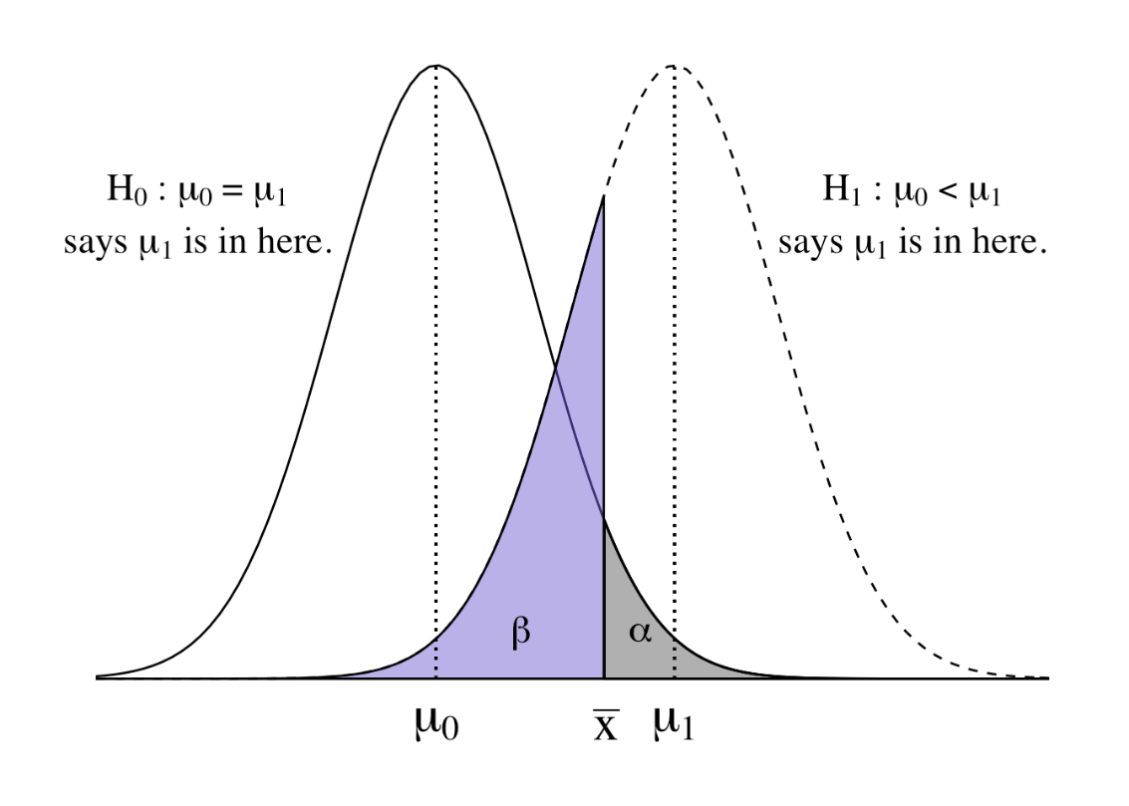
Dueling distributions
In a one-tailed test, we have two dueling hypothetical distributions:
The null distribution, centered at µ₀
The alternative distribution, centered around some specific or unspecified other mean (higher or lower?) µ₁
Notes:
To the left of alpha – reject H0
To the right of alpha (beta) – reject H0, but maybe wrong?
Where is the region where you correctly reject?

Slide 23
Finding 𝛃 (and 1 − 𝛃)
Need to know exact null distribution (just as with NHST)
Also need to know exact alternative distribution of the test statistic
Often requires some specialized statistical knowledge
In general, it is much more likely that expressions for the null distribution of the test statistic will be available than expressions for the non-null distribution.
Notes:
One-sample T allows us to explore

Slide 24
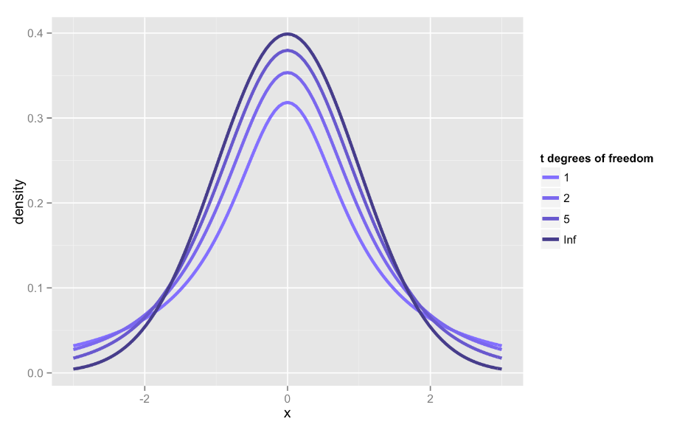
Recall student’s t-distribution

Slide 25
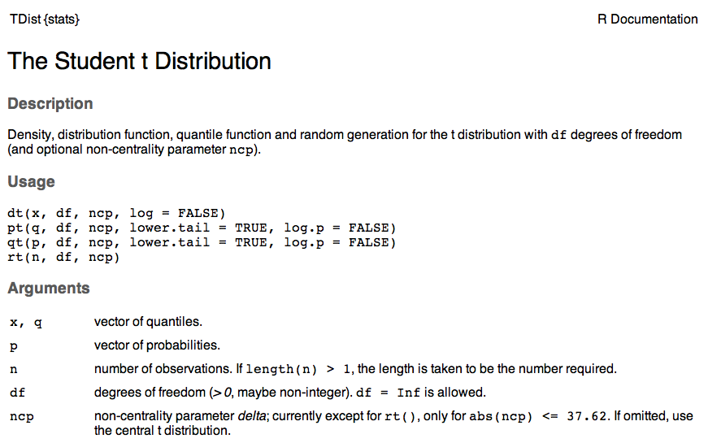
Notes:
Going to go through this quickly – will likely NEVER calculate the ncp again.

Slide 26
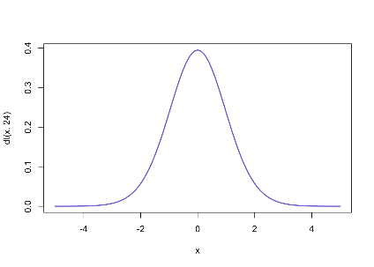
Central t-distribution (ν= degrees of freedom)
𝝳 = 0
Mean = 0
Variance slightly > than N(0, 1)
Kurtosis (biased) is > 3
Symmetric

Slide 27
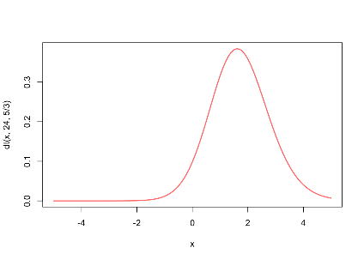
Noncentral t distribution (ν= degrees of freedom)
𝝳 ≠ 0
Asymmetric: skewed in the direction of 𝝳
Notes:
E(T) = \begin{cases}
\delta \sqrt{\frac{\nu}{2}} \frac{\Gamma((\nu - 1)/2)}{\Gamma(\nu/2)} & \text{if }\nu > 1 \\
\text{Does not exist} & \text{if }\nu \leq 1
\end{cases}

Slide 28
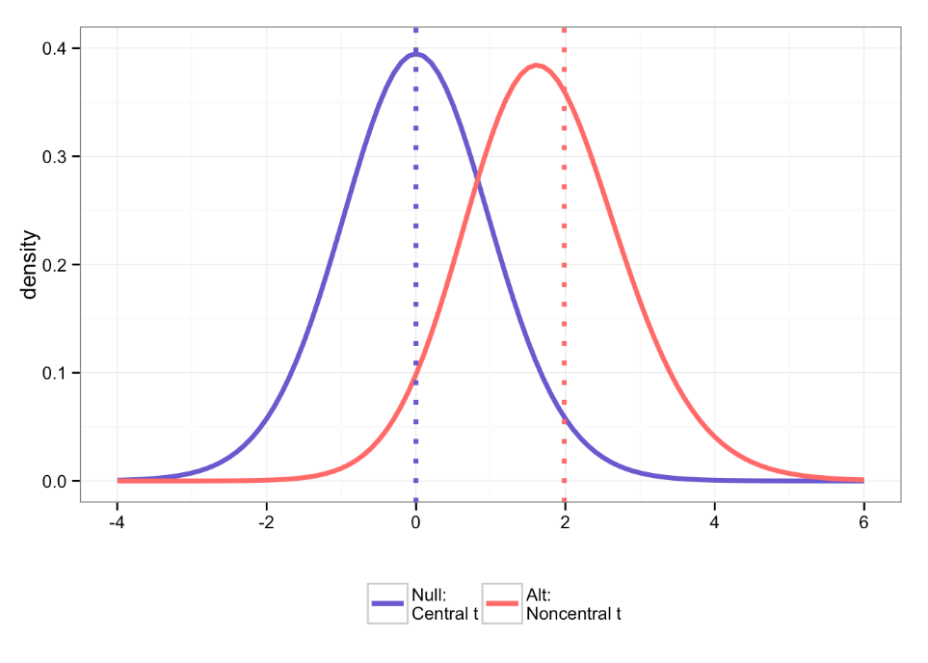
One-tailed test

Slide 29
How do we calculate the ncp?
The noncentrality parameter (ncp) is defined as:
Where E_{s} is the standardized measure of effect size…how do we calculate this?
Notes:
Look in the help for pt

Slide 30
Effect size for t-test
What is not in this formula?
Notes:
s would be a pooled sd, but since this is a one-sample test…

Slide 31
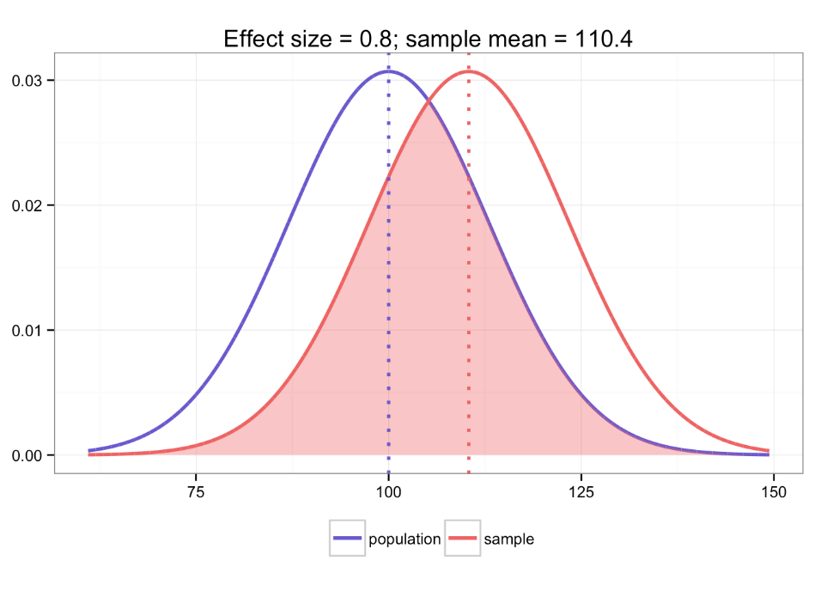

Slide 32
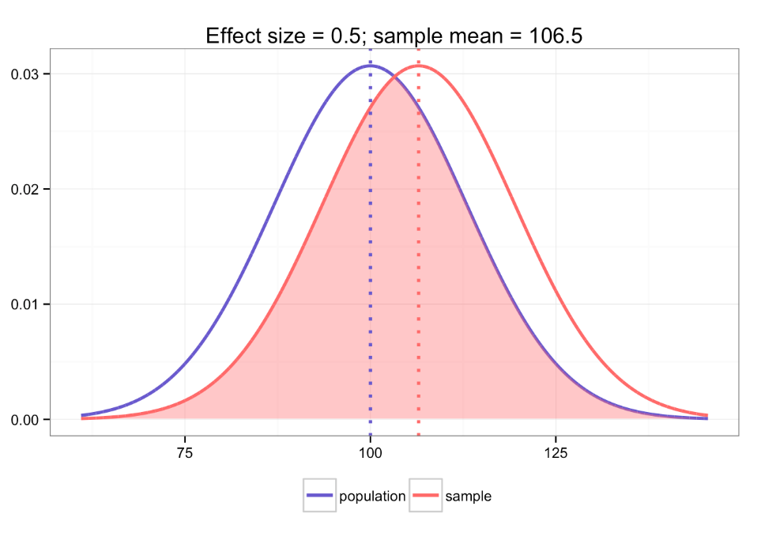

Slide 33
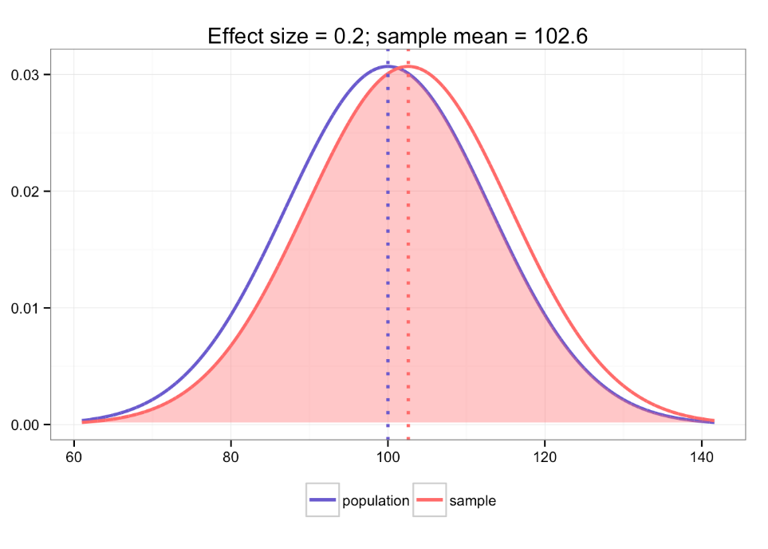

Slide 34
Calculating effect size and ncp
In our example, the E_{s} is defined just by the sample mean, null mean, and the sample s.d., so the ncp is:

Slide 35
The null and alternative t-distributions
Use alternative distribution to solve for 𝛃

Slide 36
POWER: p(true positive) = 1 − 𝛃
So power is the probability of exceeding the rejection point in this noncentral t distribution.
qt(.95, 24) # t_{critical}, null dist
[1] 1.710882
pt(qt(0.95, 24), 24, 25/13) # beta
[1] 0.4115342
1 - pt(qt(0.95, 24), 24, 25/13) # power
[1] 0.5884658
One-tailed test

Slide 37
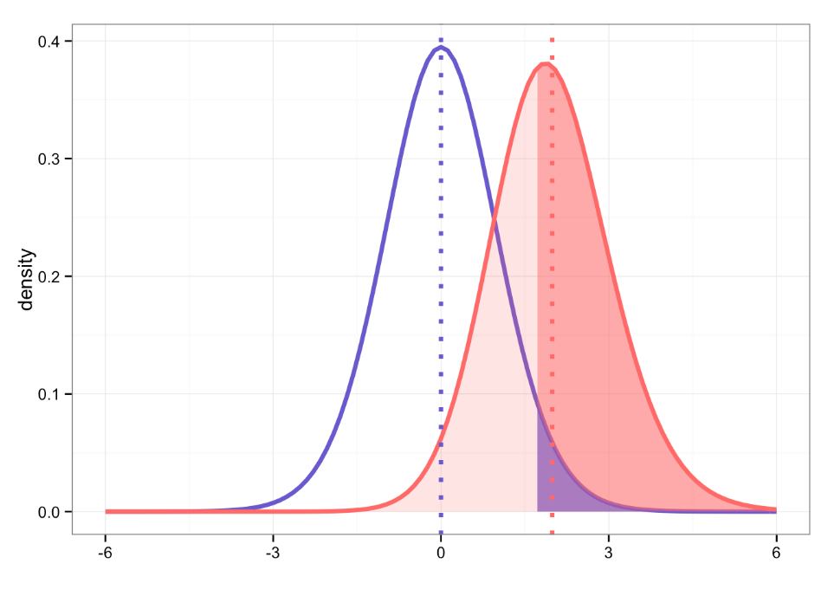
Where are:
𝝰, 𝛃, power?
Notes:
Now to the easy way!

Slide 38
Power
power.t.test(n = 25, delta = 5, sd = 13, type = "one.sample", alternative = c("one.sided"))
One-sample t test power calculation
n = 25
delta = 5
sd = 13
sig.level = 0.05
power = 0.5884658
alternative = one.sided
Good for: “post-mortem” power analysis
One-tailed test
delta here is confusing: it is neither the ncp nor the effect size- it is the raw difference between means you wish to detect
Notes:
This is what you’re really going to do….

Slide 39
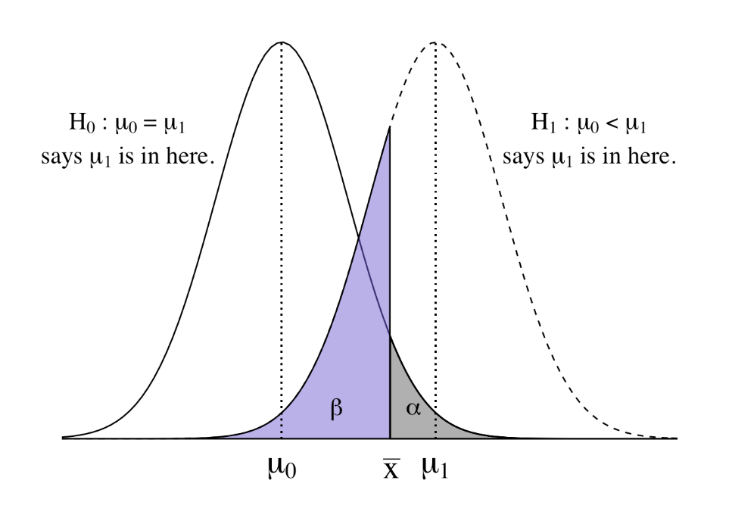
What will happen to 𝛃 if I make 𝝰 smaller?

Slide 41
Factors that affect Power (1 – 𝛃)
Sample size
Increased n reduces SE_{mean}
Level of significance
Power increases as 𝝰 increases
Reliability of your measure
Classical test theory: total variance = true score variance + error variance
Effect size (sds between the true mean & the one hypothesized in H₀; µ − µ₀ )
Population variance
Decreased variance reduces SE_{mean}

Slide 42
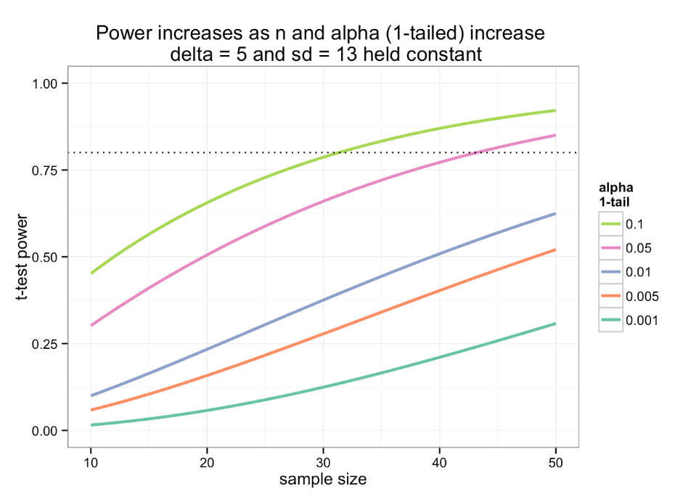

Slide 43
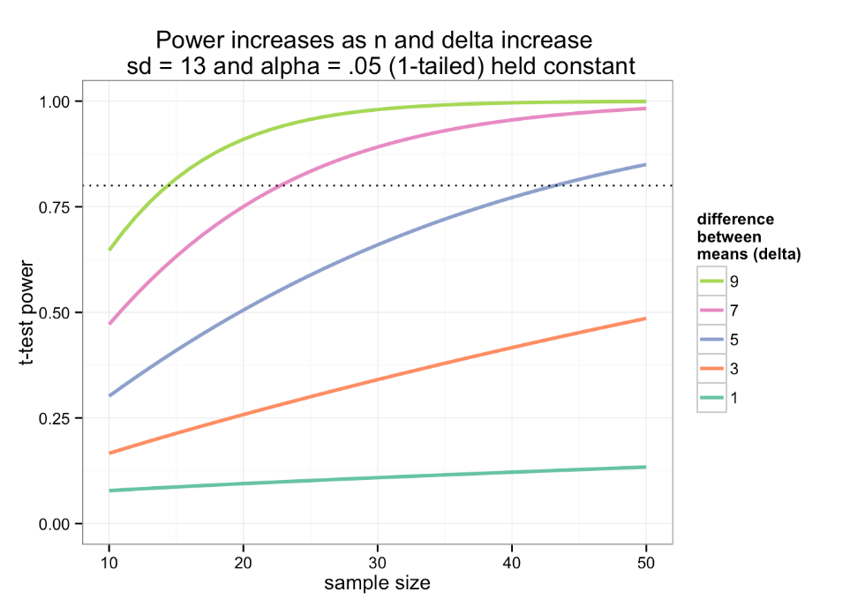

Slide 44
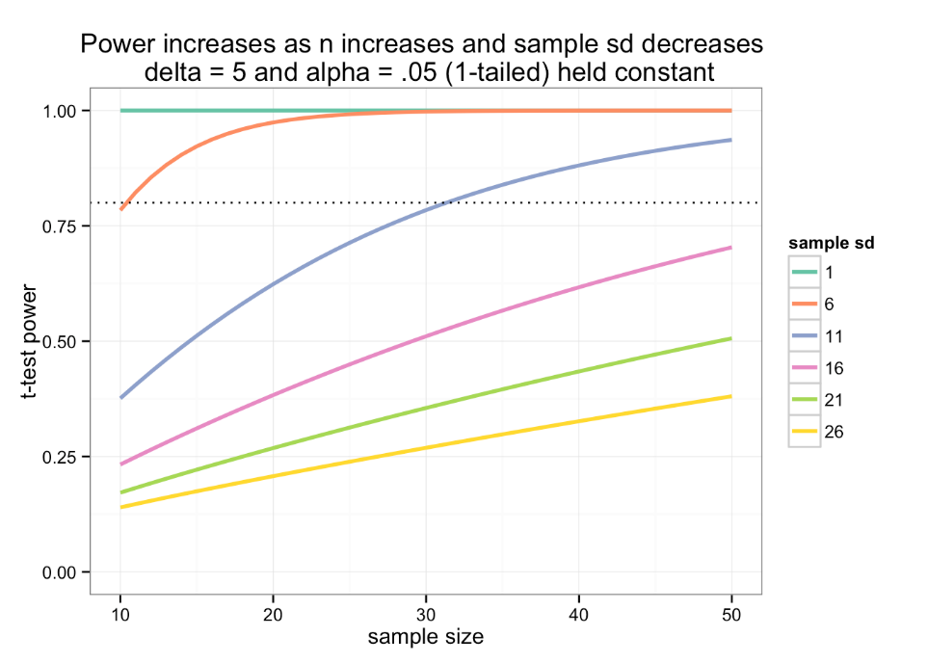

Slide 45

How large would our “n” have to be?
To detect:
Δ= 5
1 − 𝛃 = .80
𝝰 = .05
With s.d. = 13
Good for: a priori sample size determination
One-tailed test

Slide 46
Sample size determination
power.t.test(n = NULL, delta = 5, sd = 13, sig.level = .05, power = .80, type = "one.sample", alternative = c("one.sided"))
One-tailed test

Slide 47
Sample size determination
power.t.test(n = NULL, delta = 5, sd = 13, sig.level = .05, power = .80, type = "one.sample", alternative = c("one.sided"))
One-sample t test power calculation
n = 43.17957
delta = 5
sd = 13
sig.level = 0.05
power = 0.8
alternative = one.sided
One-tailed test

Slide 48
Sample size determination
power.t.test(n = NULL, delta = 5, sd = 13, sig.level = .05, power = .80, type = "one.sample", alternative = c("one.sided"))
One-sample t test power calculation
n = 43.17957
delta = 5
sd = 15
sig.level = 0.05
power = 0.8
alternative = one.sided
One-tailed test

Slide 49
How small of an effect could we detect…
If we knew we could get:
n = 100 high school girls who are aspiring astronauts
And we wanted:
1 − 𝛃 = .80
𝝰 = .05
With s.d. = 13
One-tailed test

Slide 50
Effect size determination
power.t.test(n = 100, delta = NULL, sd = 13, sig.level = .05, power = .80, type = "one.sample", alternative = c("one.sided"))
One-tailed test

Slide 51
Effect size determination
power.t.test(n = 100, delta = NULL, sd = 13, sig.level = .05, power = .80, type = "one.sample", alternative = c("one.sided"))
One-sample t test power calculation
n = 100
delta = 3.254735
sd = 13
sig.level = 0.05
power = 0.8
alternative = one.sided
One-tailed test

Slide 52


Slide 53
Let’s play….
Notes:
Go to Mote and code

Slide 54
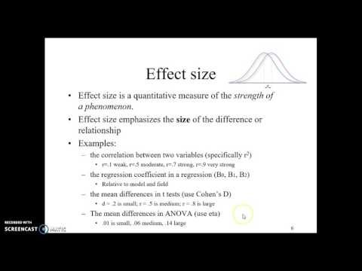
Notes:
Courtney Vidacovich

